Slide 1
Manipulator kinematic error calibration model

Slide 2
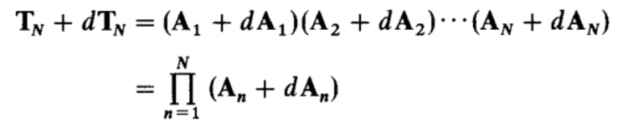
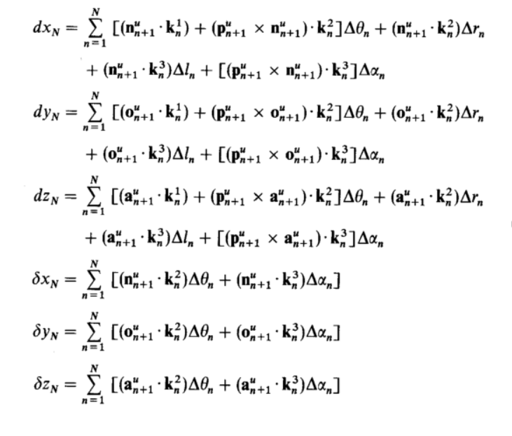
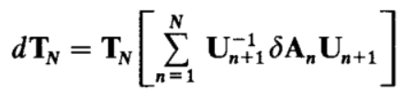
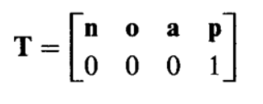


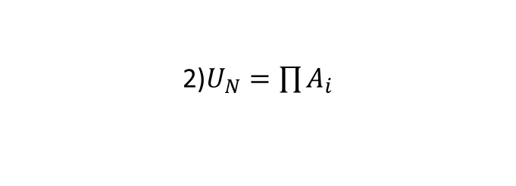
Theoretical background
1)$T_{N}$- end position;${dT}_{N}$ - error matrix
4)After simple math transformations:
2)$U_{N}=\prod{A_{i}}$
3)Where $T$ :

Slide 3
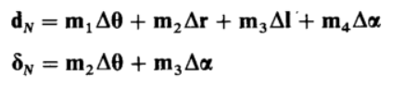
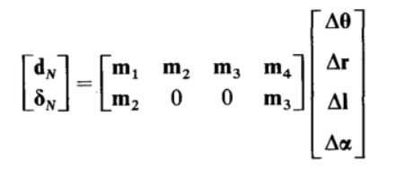


Matrix form and calibration steps
Matrix form:
Calibration steps:
Setting reference DH parameters and slightly modified DH parameters
Forward kinematics calculation
Jacobian calculation
Calculation of corrections to DH parameters
Error calculation
$$δT_{N}=JΔ_{DH}$$
$$Δ_{DH}=J^{+}δT_{N}$$

Slide 4
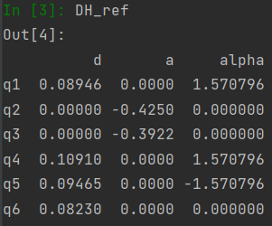
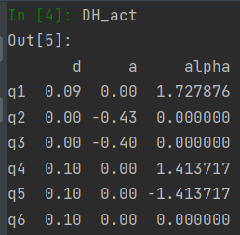
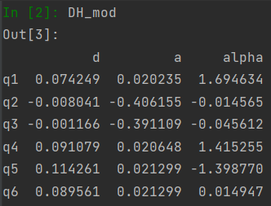
Simulation
DH-parameters:
Reference:
Actual:
Modified:

Slide 5
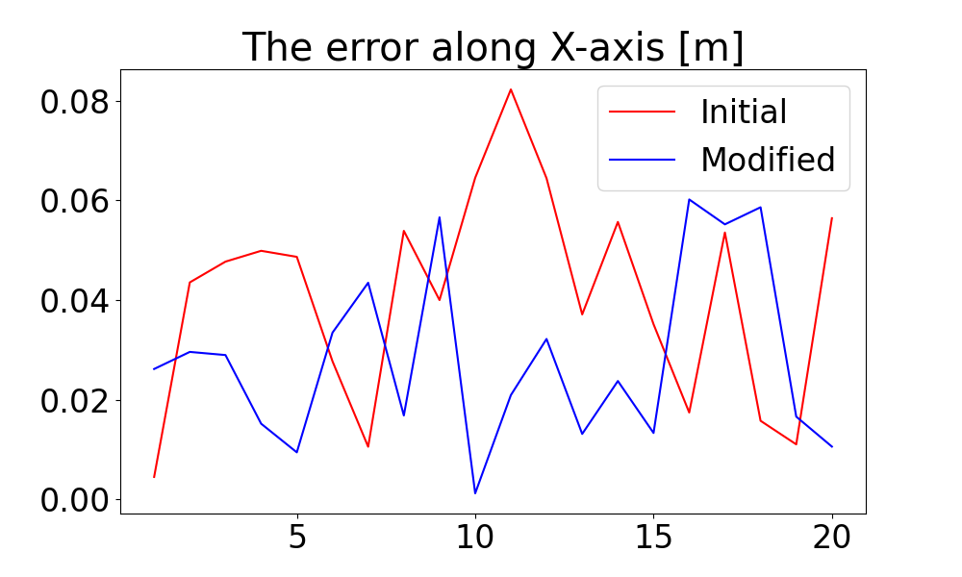
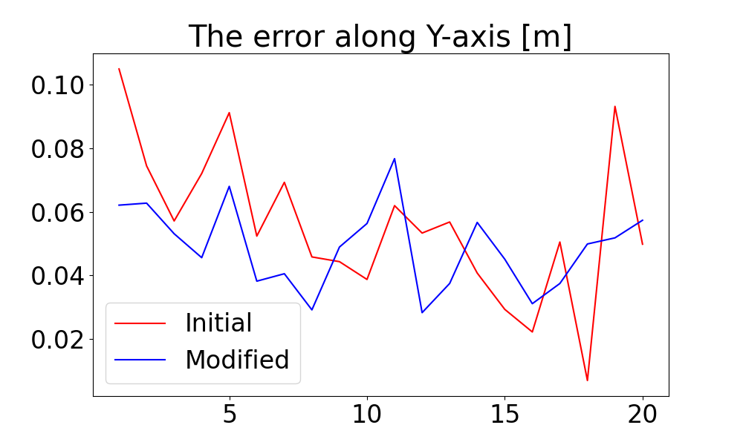
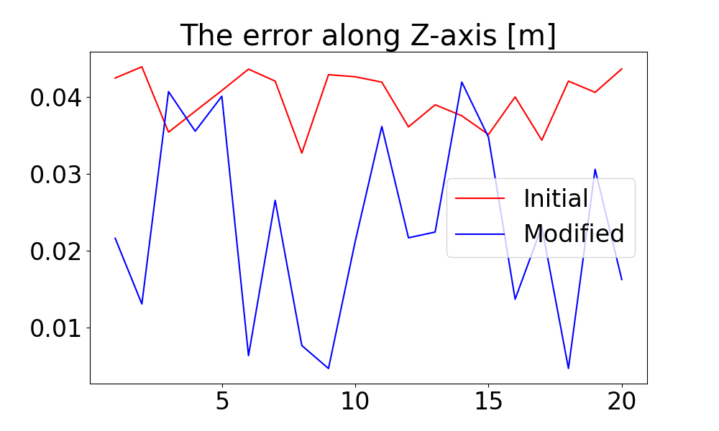

Error graphs
Result: 26% accuracy increasing

